Slide 1

How to test the whole firmware/software when the RTL can’t fit the emulator
Horace Chan, Byron Watt – Microchip Technology
Optional Company Logo
(show on Title Slide ONLY

Slide 2
Agenda
Introduction
Challenges
Existing Solutions
Architecture of the Hybrid Software Simulator
Use Mode on Testing User Space FW
Use Mode on Testing Kernel Space FW
Results

Slide 3
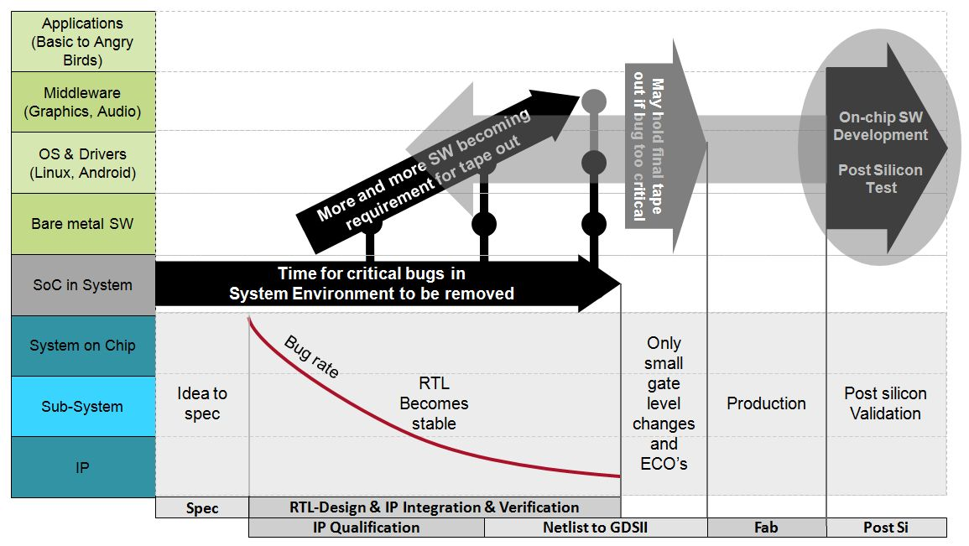
Introduction
Pre-silicon FW/SW testing using emulation is a MUST
Catch system bugs before tape-out

Slide 4
The problem
The design is too big to fit in the emulator
Buy bigger emulators (if you ask the EDA vendor)
$$$$
Borrow an idea from verification
Blackboxes RTL logic not required by the test
Build multiple design snapshots for different test scenarios
Save up to 50% of gates on average

Slide 5
Challenges
Notes:
Access blackboxed addresses
AXI bus lock up
CPU stalls
PCIe hangs
host Linux freezes

Slide 6
Existing Solutions
Run block level FW in verification TB
Tried this approach in previous project
Can’t test the whole FW/SW before silicon
Can’t find integration bugs
The verification team hate it.
Extra C code to debug on top of the RTL.
The FW is not as verification-friendly as UVM sequences

Slide 7
Existing Solutions
Use of #ifdef or makefile parameters to partition the FW
Tried this approach in previous project
Spent lots of unproductive hours hacking the FW code
add #ifdef all over the place
create mock function to bypass register access into blackboxed addresses
It is a maintenance nightmare on RevB
This solution doesn’t scale

Slide 8
Existing Solutions
Insert dummy AXI/AHB slave components in the blackboxed RTL
Investigated this approach in the beginning of this project
Too much work to create the blackboxed SV modules
Too much work to hack the RTL compile script for emulation
Can’t model the blackboxed RTL behavior
AXI/AHB dummy only returns zero on read

Slide 9
Existing Solutions
Use of a Virtual Platform
Investigated this approach in the beginning of this project
Too time consuming to setup QEMU proxy and SystemC models
Inconvenient to debug the FW code compare to our approach
Doesn’t work for us, but it might be the right choice for a different project

Slide 10
Our Hybrid Emulation Scenario
A x86 Linux server controls multiple chips via PCIe bus in the production environment
The PCIe bus is replaced by the PCIe speed bridge in the emulation environment
The embedded CPU inside the chip is also running Linux
The SW running on the host Linux communicates with the FW running inside the embedded Linux via TCP sockets or PCIe mailbox.
The end-user has no direct access into the FW. The end-user interacts with the FW through the public API of the SW running on the host Linux

Slide 11
Hybrid SoftWare SIMulator
Notes:
Generate from register description files (IP-XACT)
Hybrid Software Simulator
System Verilog register implementation
C header files for the FW
embedded view (direct AXI write/read)
HSWSIM view (TCP to HSWSIM)
Features of the Hybrid Software Simulator
Shadow register bank
Address filter/translator to the emulator
Trigger callback functions to model RTL behavior

Slide 12
Test User Space FW
Notes:
User Space FW are non-timing critical
Extra latency of PCIe is irreverent
Run everything on host Linux
Faster debug turn around time
Can use any IDE as the gdb client
Can mix and match TB config sequences with the FW

Slide 13
Test Kernel Space FW
Notes:
Kernel space FW are ISR and Linux drivers
Has to run on the embedded CPU
User space FW is already bug free
Fake the behavior of blackboxed RTL with HSWSIM
Debug like real silicon
printk on UART,
DSTREAM on JTAG
Note: RTL used by the kernel space code cannot be blackboxed

Slide 14
Results (pre tape-out)
All major FW features are tested in emulator
Design running at 5Mhz in the emulator
Linux boots up in less than 5 minutes
Found 3 RTL bugs before tape-out

Slide 15
Results (Silicon)
Smoothest bring up for a Rev A device
Linux and FW running on day 1
First major feature running on day 3 (debug non-digital FW code)
All major features running on the first week
First FW release to customers in less than a month
Pin point a corner case RTL bug discovered in Silicon testing
Simulation can’t reproduce the bug, it takes a few seconds to run on silicon
Emulation sees the bug, dump waveform and let the designer diagnose the problem.
With the new insight from emulation, simulation is able to reproduce the bug in 2 hours

Slide 16
Q & A

